Slide 1
Investment Performance Mobile App
Sponsored by HEDGESERV Created By: Avi Sinha Tyler Jones
Samuel Cooney

Slide 2
Project Recap: Purposes and Goals
The primary goal of this project is to supplement a user’s investment experience
Timely comparative financial data
Allow user to make more informed decisions regarding an investment or an entire portfolio

Slide 3
Backend
MySQL OSU Hosted Database
Basic Structure
2 important Many-to-Many relationships
Users to Portfolios
Portfolios to Investments

Slide 4
Problems
Regardless of research, ignorant to some necessary pieces of application. Learning a lot!
How to create the needed data relationship and data flow into application
Didn’t know what an API was
Never done Mobile Development
TA miscommunication

Slide 5
Solutions
Much research involved
Need for REST API and Web Service
Large chunk of man hours teaching myself what necessary components are and how to make them

Slide 6
Code Demo

Slide 7
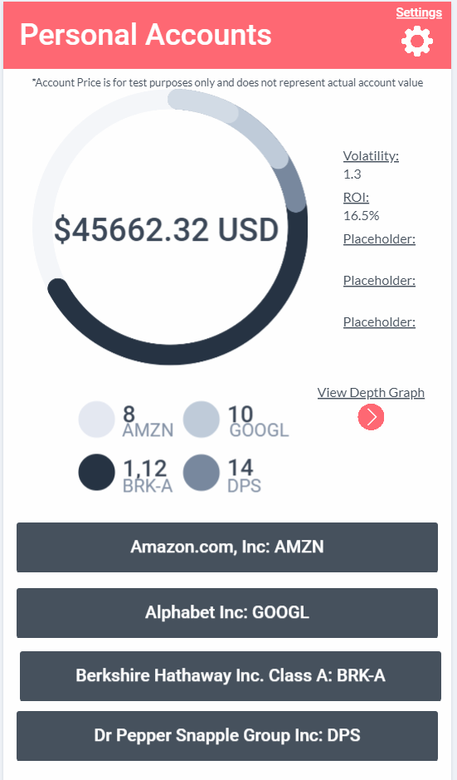
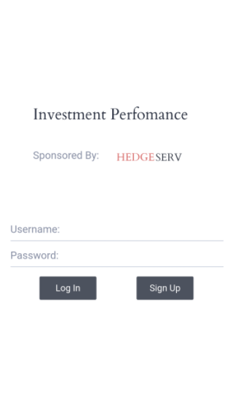
Current
State of UI
Current functionality implemented
UI Mockup for Beta Release Designed
Early Stages of Beta UI in development

Slide 8
UI problems:
Solutions:
Native Libraries do not allow for single codebase
Layout structure
iOS Development
Xamarin.Forms
Research! Research! Research!
Mac Developments

Slide 9
Demo of alpha UI functionality

Slide 10
Demo of alpha UI Design

Slide 11
What’s next for UI?

Slide 12
Demo of alpha UI Design

Slide 13
API

Slide 14
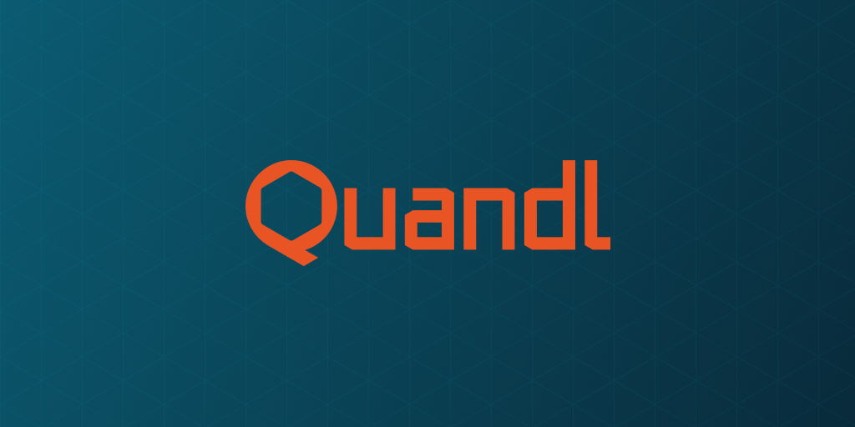
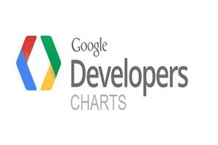
API’s and Business Logic
The application will be using 2 major API’s for data visualization and retrieval:
Quandl
Google Charts

Slide 15
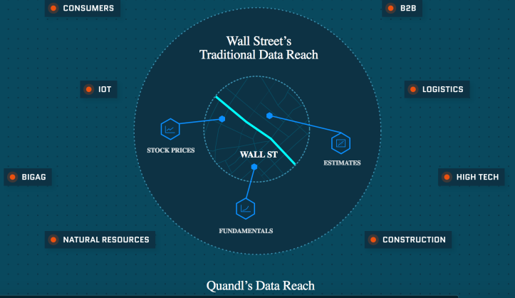
Current state of the project
The Quandl API is a little less than halfway done in terms of development and its functionality is at alpha.
The main function of the API will be able to pull general and specific financial data for the user to look at and then that data will be combined with the user data that Tyler will be providing from that database
Consisting of both time series and table of various stocks and options
Since the Quandl API has been natively written for application within Python and R we are currently making it compatible for Xamarin by writing it in C#.
This data will be outputted into a JSON file.

Slide 16
What’s still left?
For Quandl we still need to set up various requests that users will be making for retrieving their financial data.
Requests include:
Download
Multiset download
Metadata download
Favorites Download
Search
Google Charts API development still needs to begin
Using data from SQL we will bind the financial data with the user data to give personalized infographics of specific stocks as well as for the specific portfolio metrics.
Mainly through the use of a ASP.NET environment and then passed into Google Charts in a JSON format.

Slide 17
Problems
API development began much later than the frontend and backend development
Originally iOS and Android development was going to be split up but we decided to use Xamarin Forms which allows for a shared codebase and won’t require 2 separate developments
Compatibility issues between Mac and Visual Studio

Slide 18
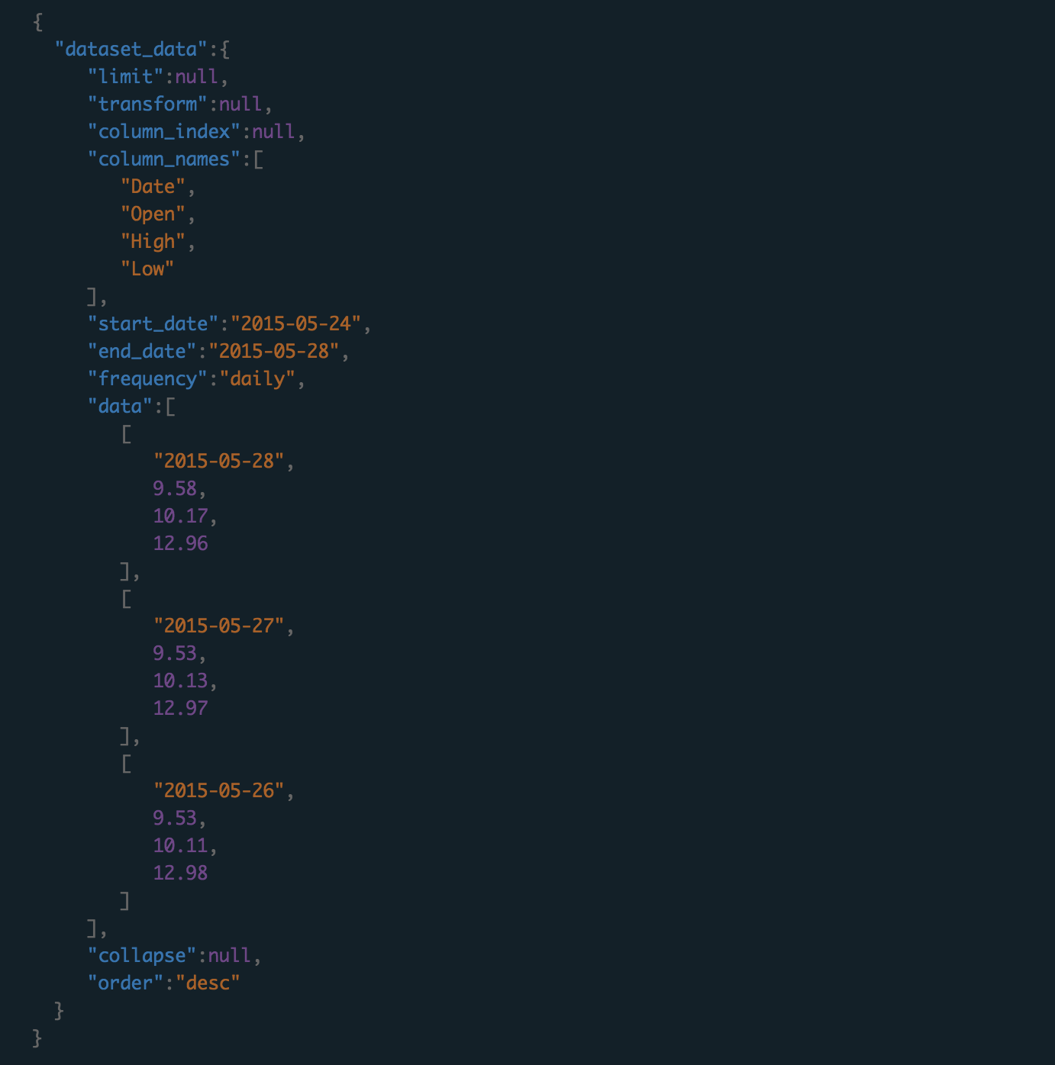
Code demo for returning data from a specific time series
Definition:
Example Request:
Example Response:

Slide 19
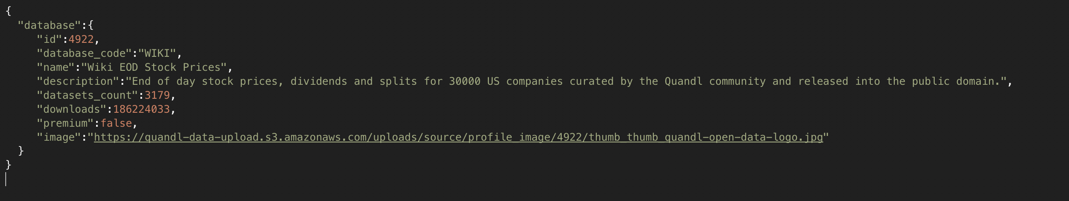
Code Demo for getting metadata of a specific time series
Definition:
Example Request:
Example Response:

Slide 20
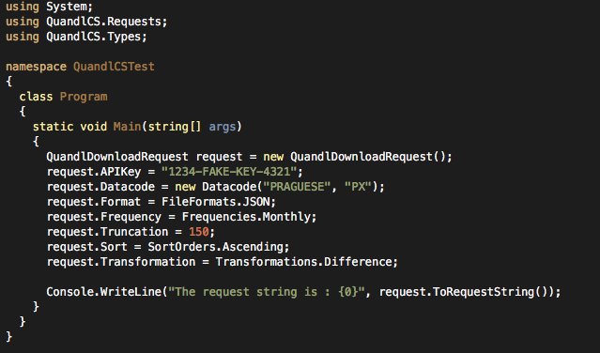
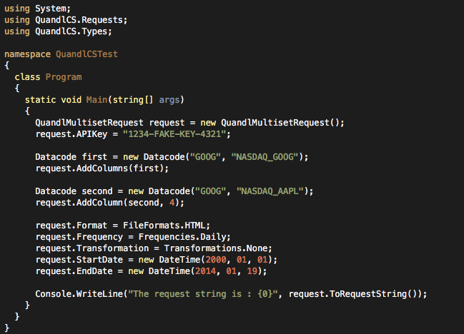
Code Demo for Download and Multidownload Requests
Download:
Multiset Download:

Slide 21
Conclusion
We’re on track for completing a beta level application by the end of winter term.
The weeks up to expo will consist of fine tuning the application’s functions and making sure the business logic is sound.
We’ll also run testing on the application and get more data on how users like the interface and and if they like the visualization of the data.

